Slide 1
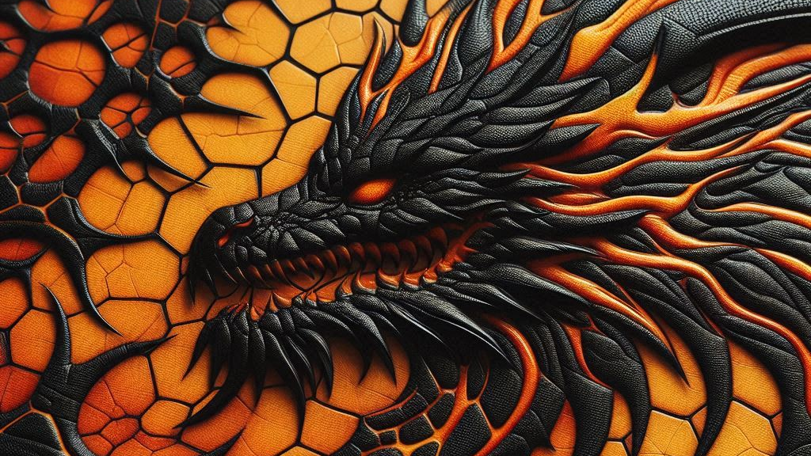
From Utopia
To Reality
The hidden challenges of E.D.A.
Ruben Scheedler
Notes:
Hi everyone. Please if you have any questions, some them for after the session and note that a hand-out is available at the end with much more content than the slides I’m using today.

Slide 2
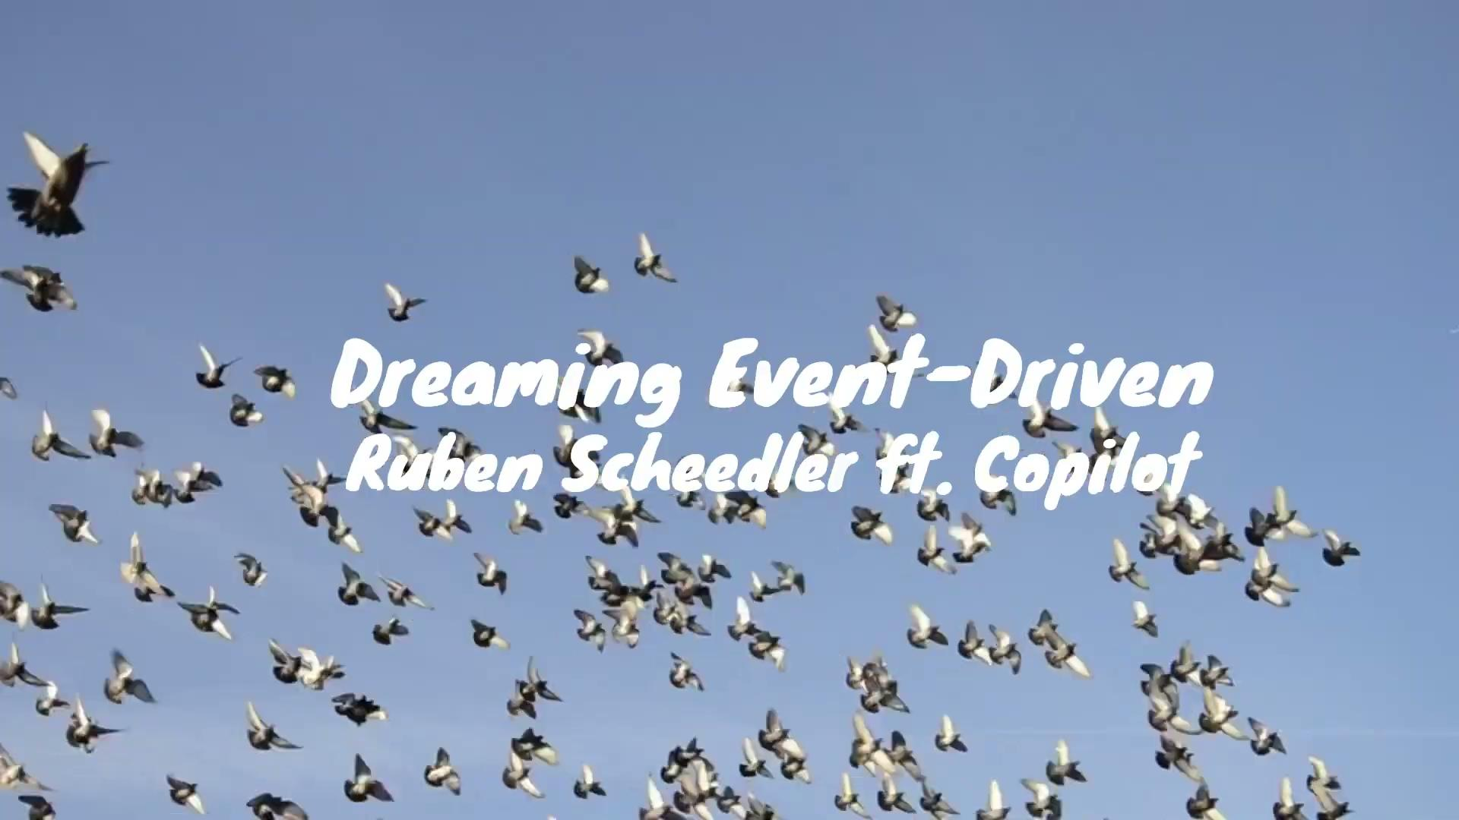
Notes:
Goal: Describe the dream

Slide 3
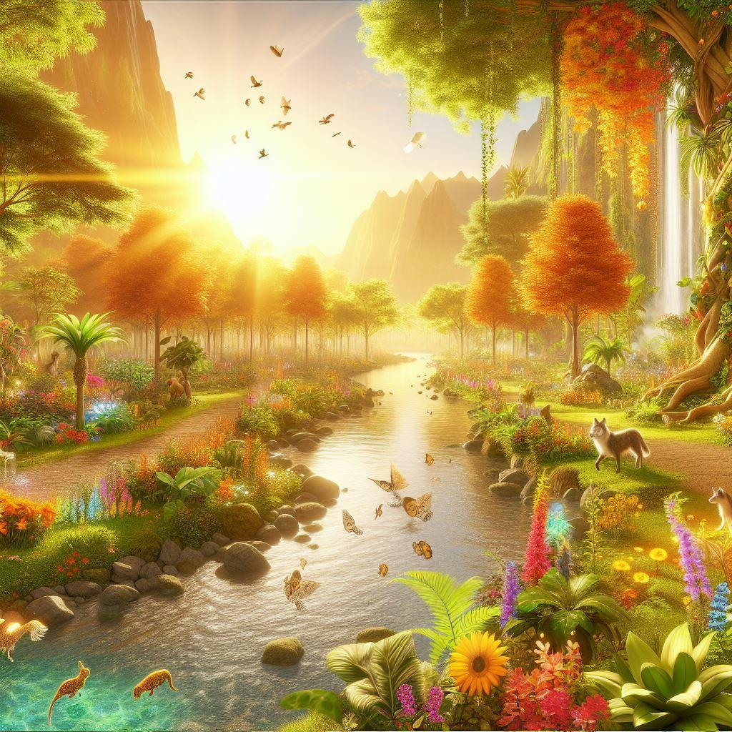
Notes:
My name is Ruben Scheedler and I too am a dreamer

Slide 4
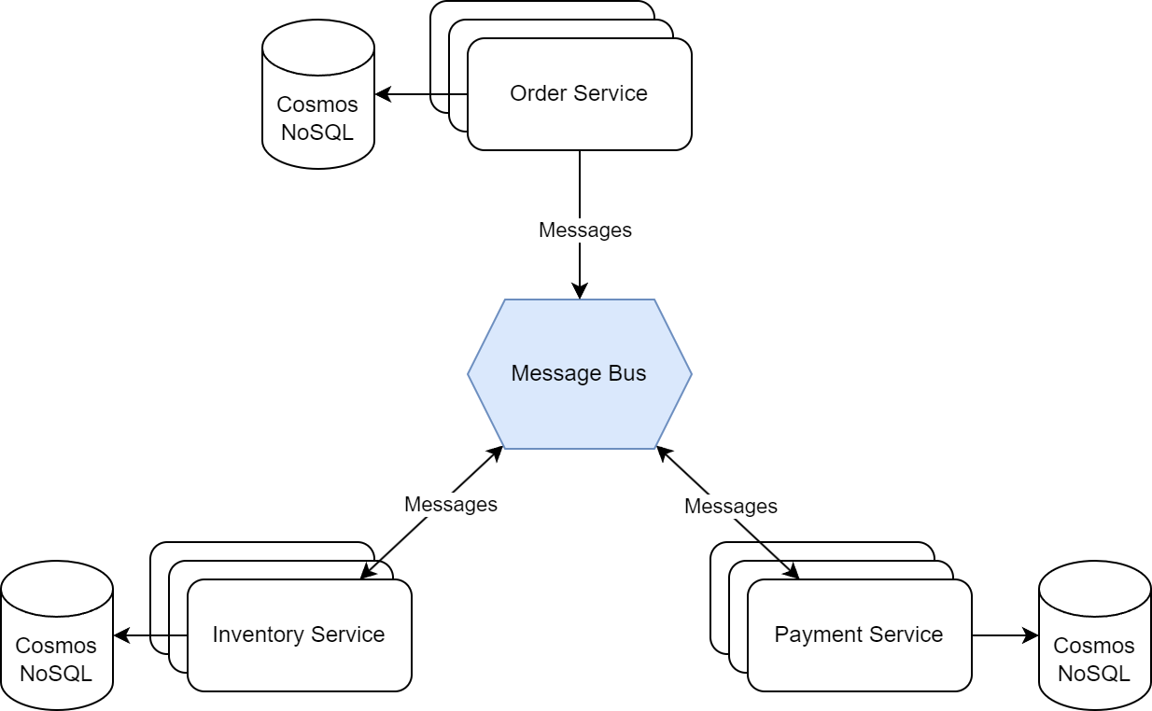

Notes:
Goals: describe the system. EDA

Slide 5



https://thenounproject.com/
scalability
availability
Resiliency
Notes:
Event driven architecture enables scaling horizontally, promotes async programming leading to better availability but also resiliency. Messages are never lost and consumers can go down without their producers suffering the consequences.

Slide 6
Notes:
I started and it felt like walking into a digital garden of eden. So pure, so right. And I started working on my first feature in this digital oasis and it was a breeze. And then came the code review. Somehow, I had missed, well, everything. Flow of control, edge-cases everything was so fundamentally different.

Slide 7
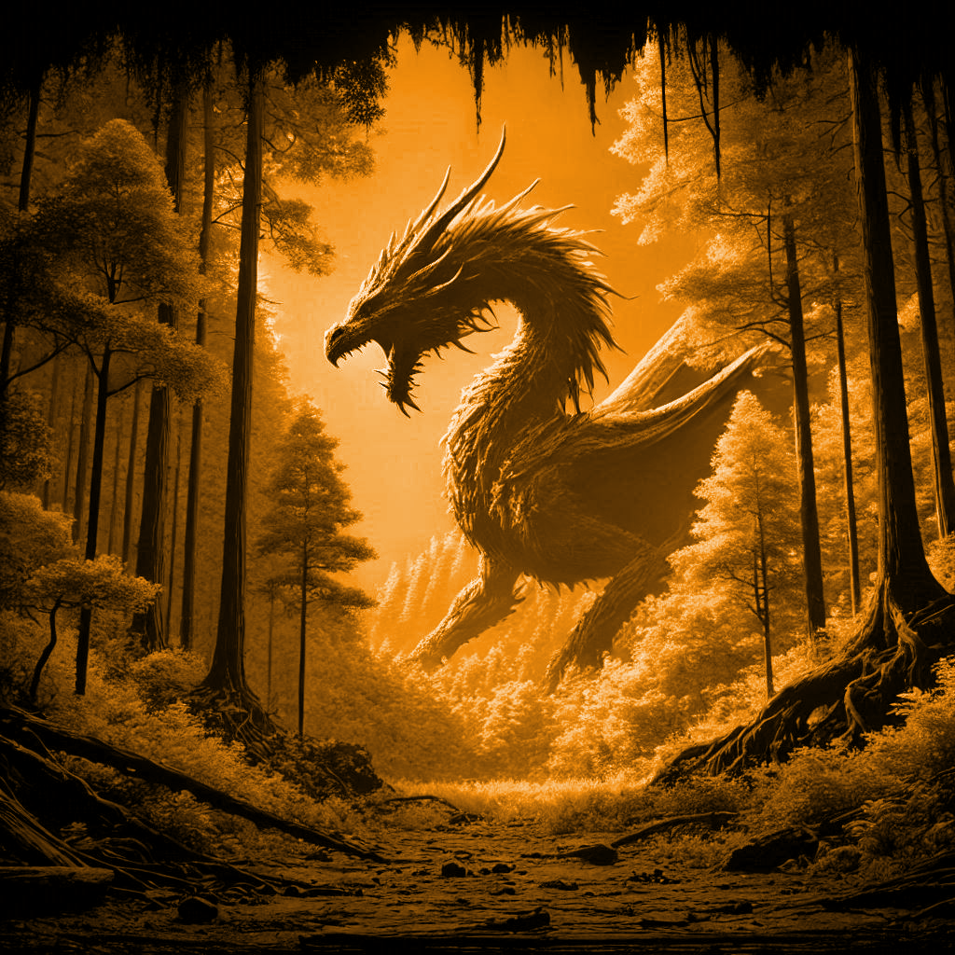
Notes:
In reality, I was facing a dragon. Powerful, but hard to tame.

Slide 8
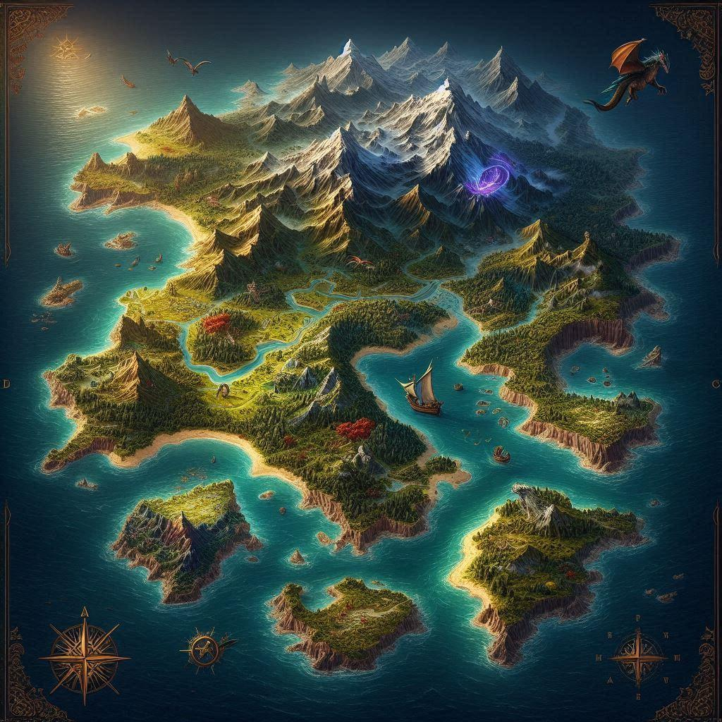
The Garden of E.D.A.
GIANTS
shape shifters
Time Travellers
Notes:
It turned out I found myself of the garden of EDA. Beautiful, yes. Only once you are ready to defeat time travellers, shape shifters and giants are you ready to tame a event driven dragon and leverage EDA.
Tell about the handout! and questions!

Slide 9
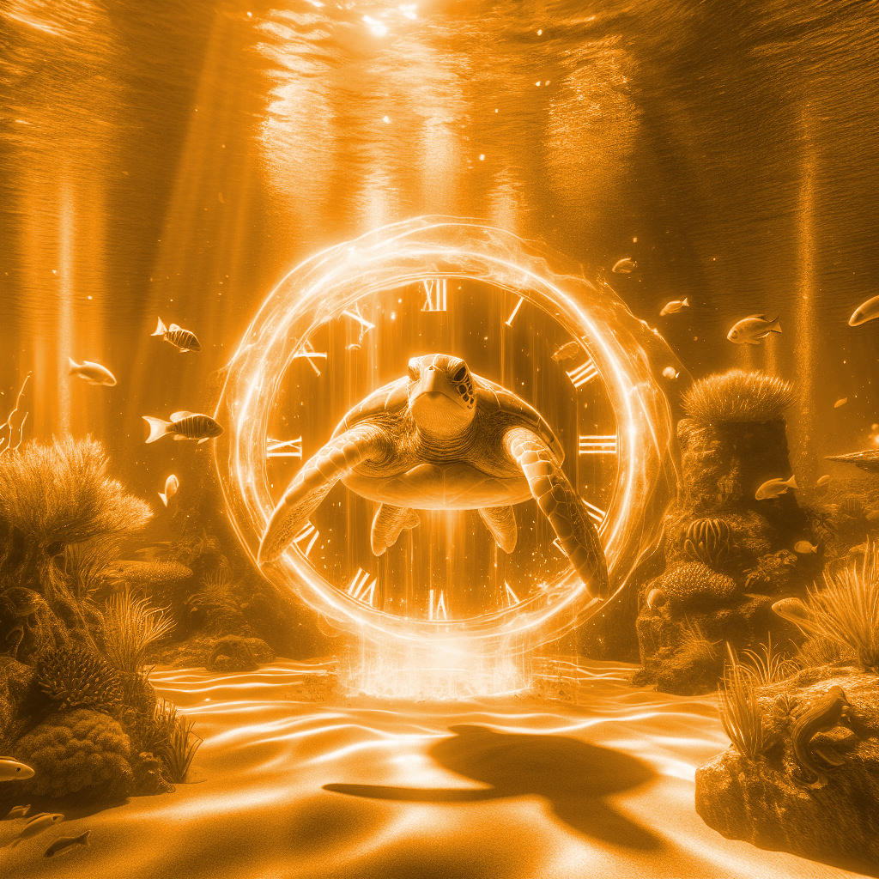
I.
Time Travellers
Notes:
[target: 8.30min] Goal: I had heard about them during my studies. But I thought they were only a legend. SWITCH TO MENTI

Slide 10
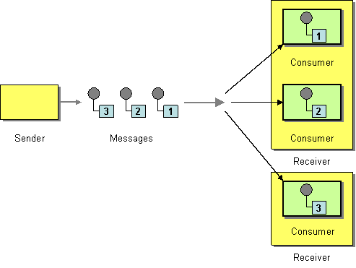
Competing Consumers
https://www.enterpriseintegrationpatterns.com/patterns/messaging
/CompetingConsumers.html

Slide 11
Restaurant
1
2
3
4
8
7
6
5
Notes:
Our example domain is a very simple reservation system for a restaurant, where users can create reservations, add tables to them and cancel reservations.

Slide 12
Add
Table
Create
Reservation
Add
Table
Time

Slide 13
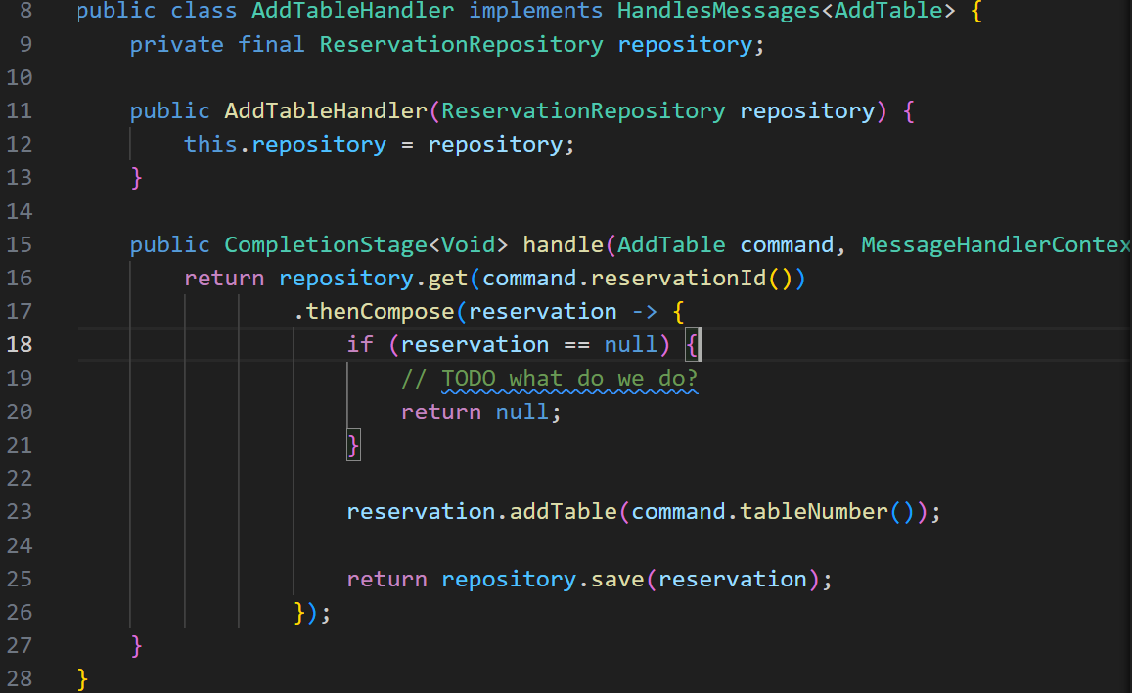
Notes:
answer: retry or create (be creative)

Slide 14
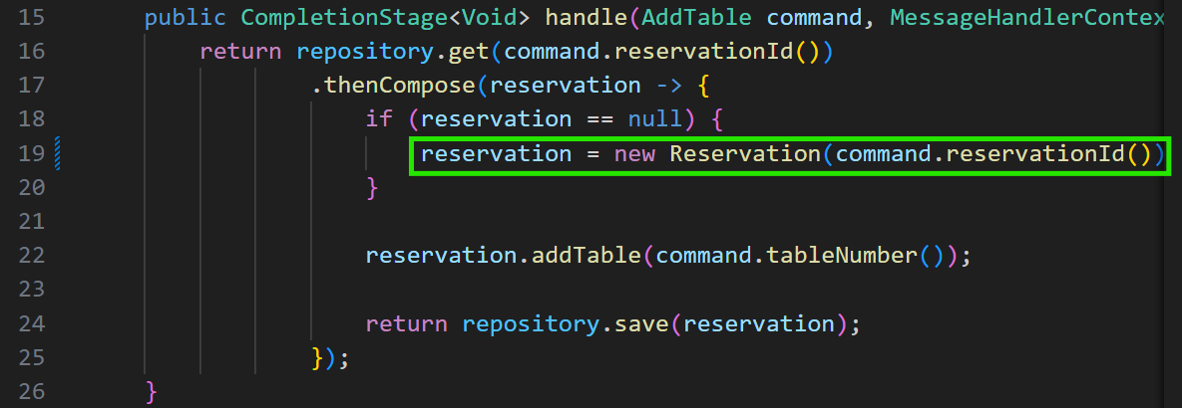

Slide 15
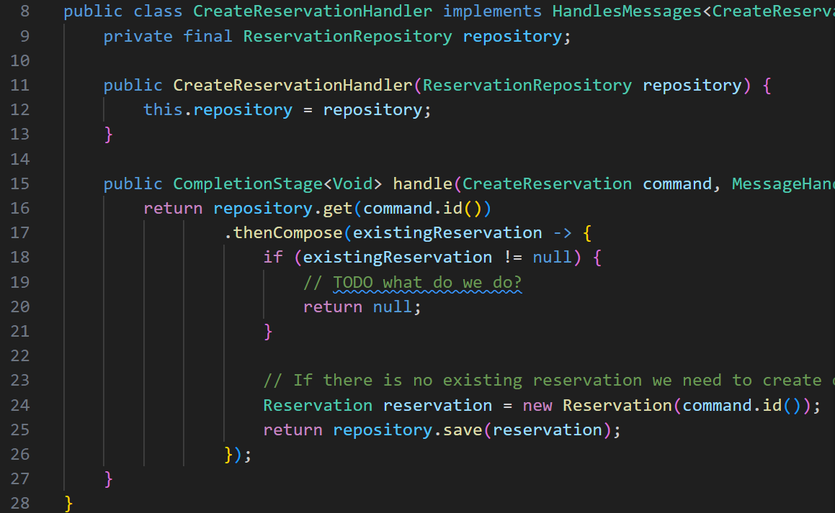
Notes:
Answer: ignore (if it is known that addTable can create it) or log. Retrying is pointless. Merge if performance

Slide 16
Create
Reservation
Remove
Table
Time

Slide 17
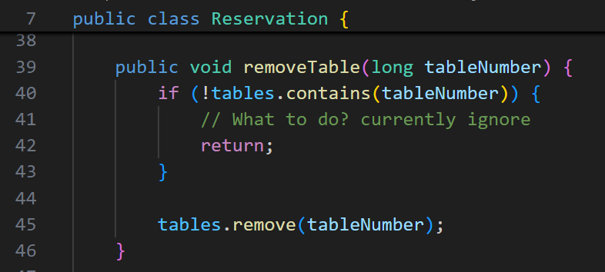
Notes:
Answer: retry! addTable could be coming

Slide 18



https://thenounproject.com/
reconsider
retry (manually)
remove/log
Notes:
How to deal with time travellers? Reconsider: is it really no creative way to handle this message? Use retry as a weapon against race conditions, but only if a retry has a chance to work. Otherwise, ignore or log it.

Slide 19
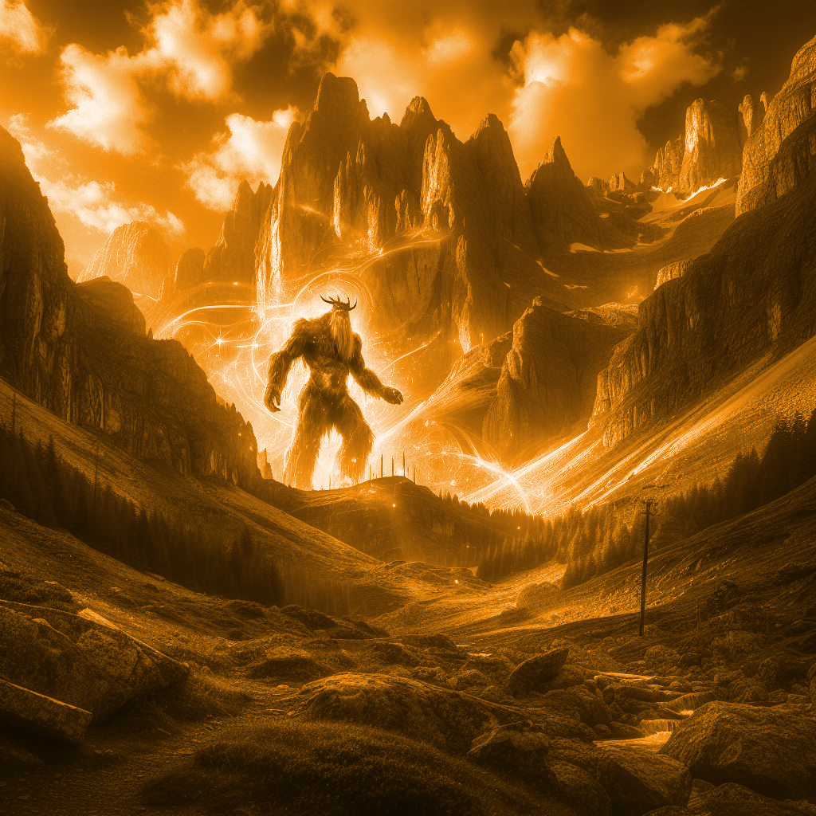
II.
Giants
Notes:
[target 21min] It is easy to forget the outside world, when working in the garden of E.D.A.

Slide 20

Notes:
Goal:

Slide 21
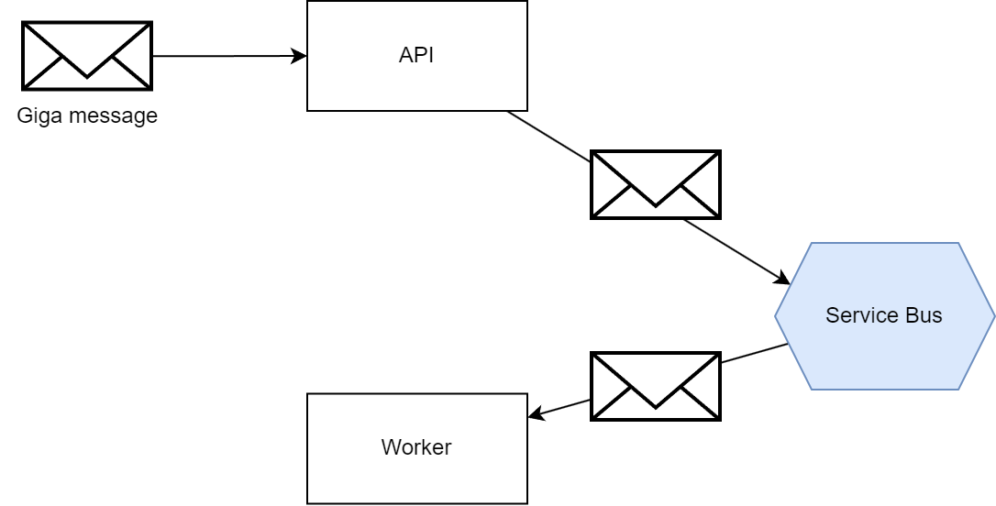
1MB
Notes:
Goal: Explain the flow. Conceptually no issues. Easy peasy

Slide 22
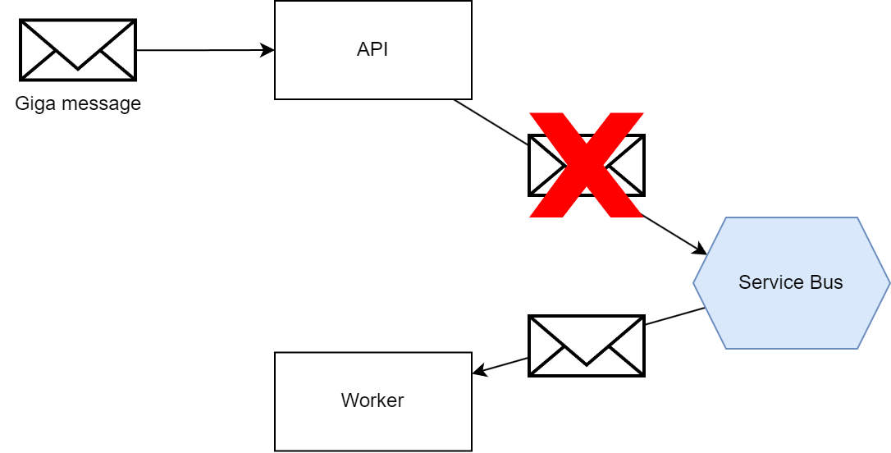
1MB
Notes:
It did not work. Anyone want to make a wild guess why not?

Slide 23
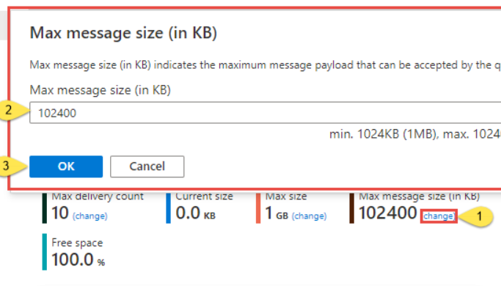
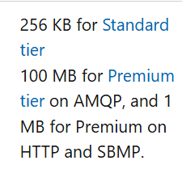
https://stackoverflow.com/questions/55487615/service-bus-explorer
Notes:
Explain max message size with tiers and config

Slide 24
1MB
Notes:
It did not work. Anyone want to make a wild guess why not?

Slide 25
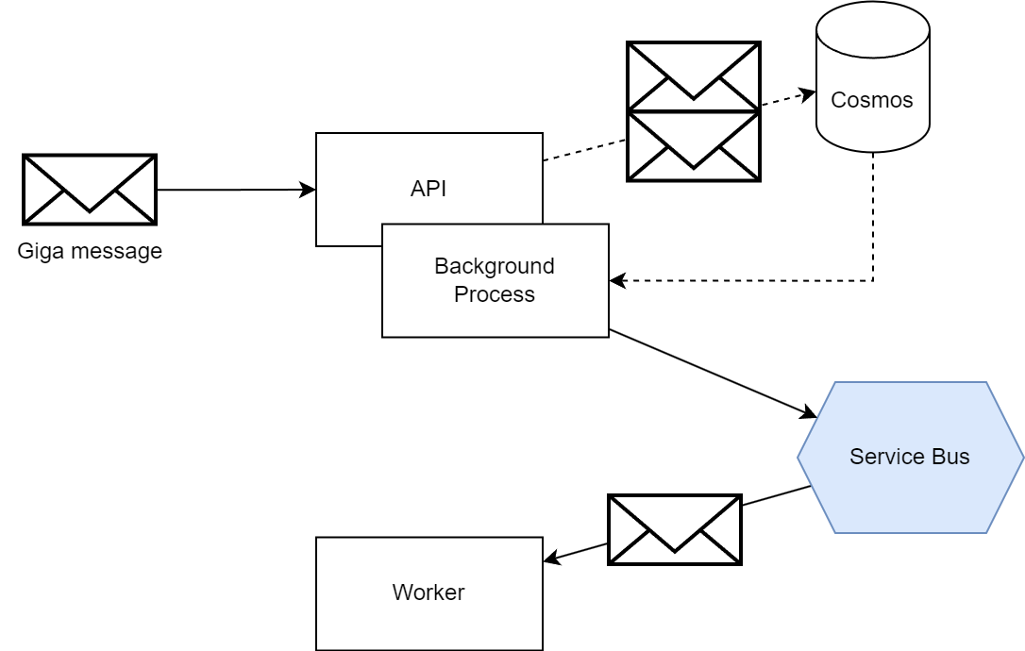
1MB
1MB
1MB

Slide 26
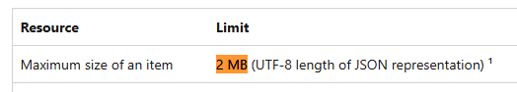

Slide 27
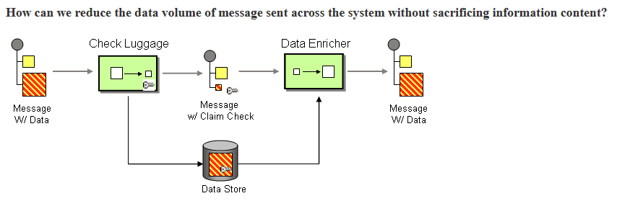
Notes:
How do we solve this? using claim checks. tags, wardrobe example

Slide 28
1MB
✓
✓
Notes:
TODO overview of the flow with a cross in the worker

Slide 29
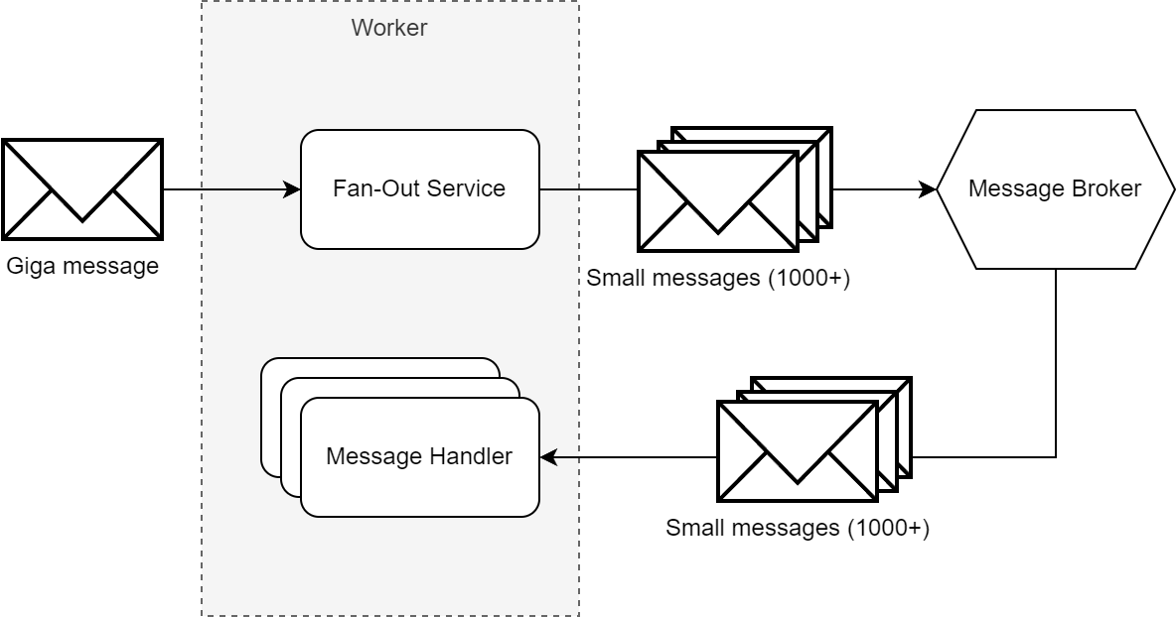

Slide 30
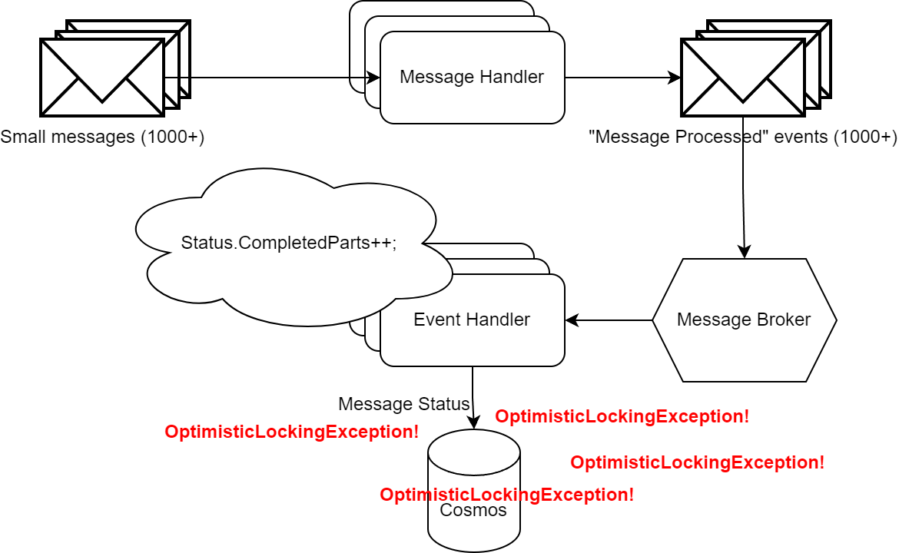

Slide 31
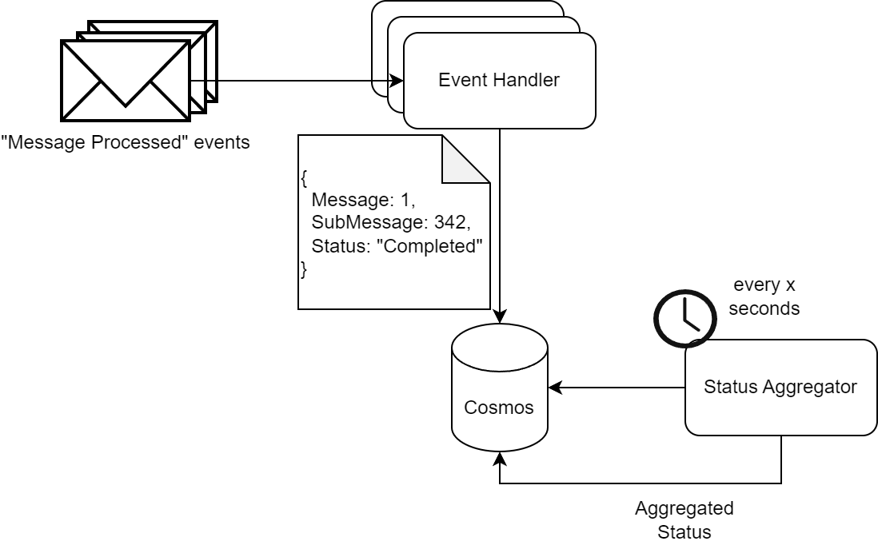

Slide 32



https://thenounproject.com/
Config
Claim Checks
concurrency
Notes:
When dealing with giants, check all configuration of your flow. Limitation can be anywhere. If you hit a hard limit, use the claim checks pattern to store the big data elsewhere. When you inevitably start splitting up the message: consider concurrency and out of order messages.

Slide 33
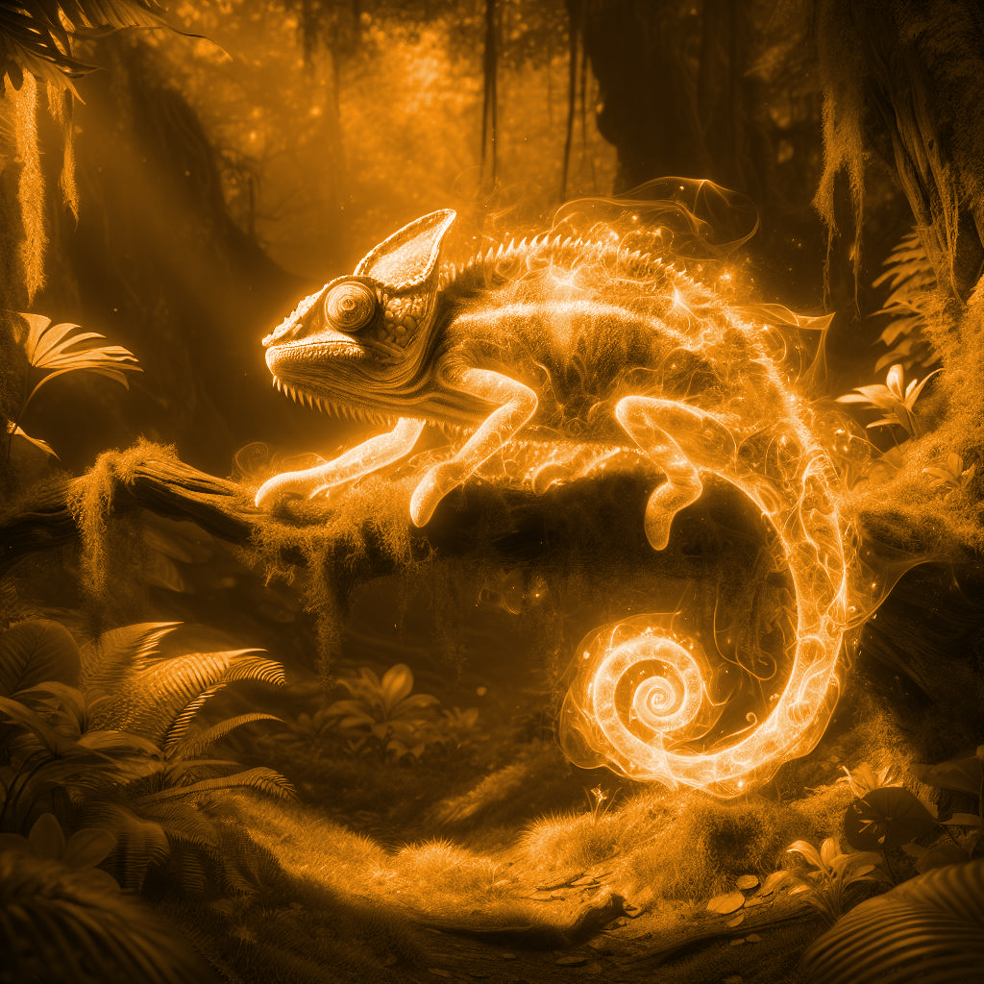
III.
Shapeshifters
Notes:
[target: 31min] I’m not going to tell what they are yet

Slide 34
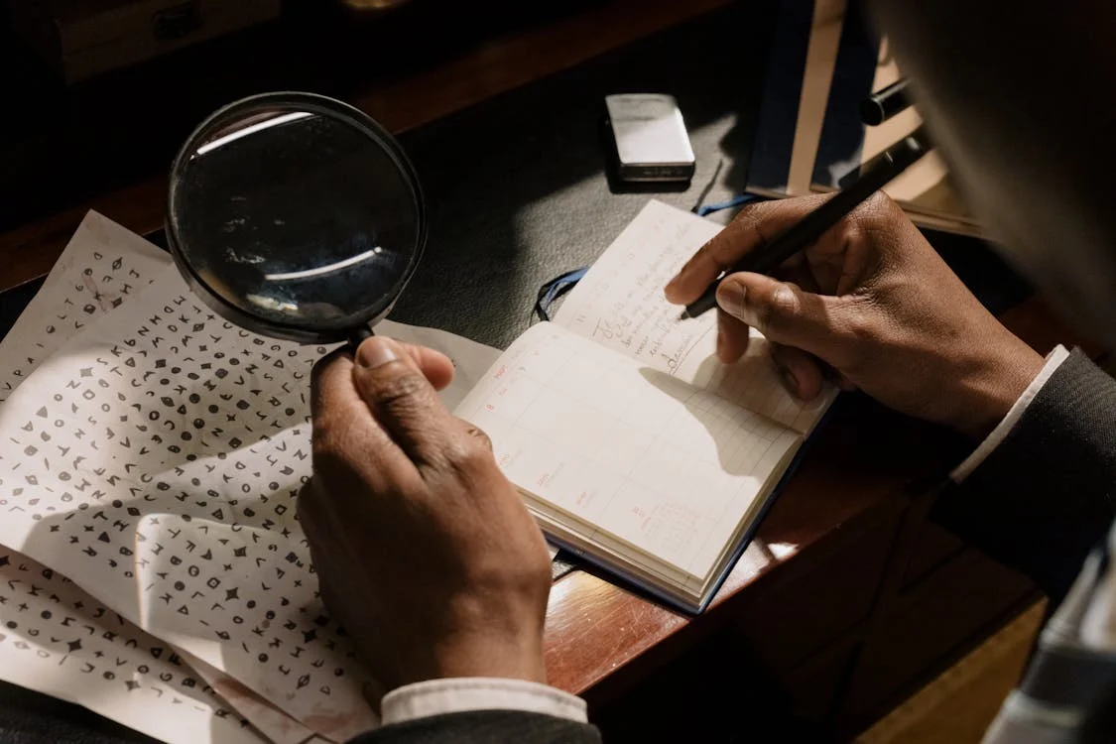
Notes:
Goal: you have to find my bug

Slide 35
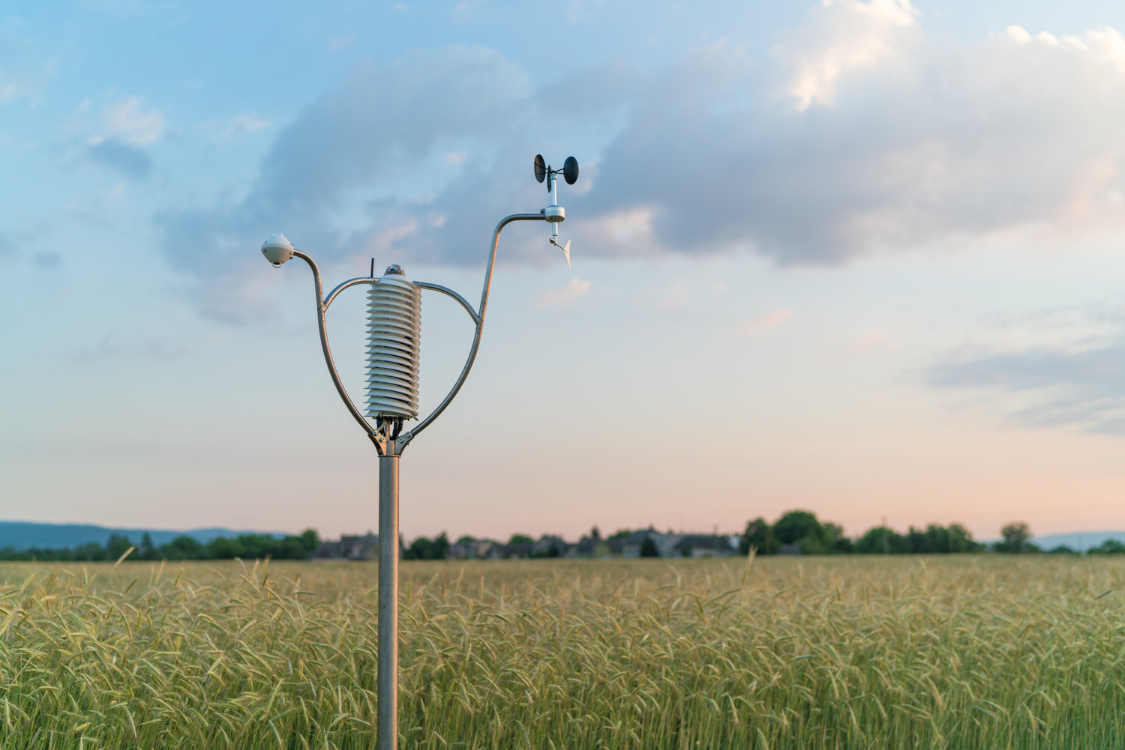
https://www.baranidesign.com/weather-sensor-gallery/ajqf9yet70uib5bdatlbyw7tdkvchf
Notes:
Country full of sensors, and an application to process that data.

Slide 36
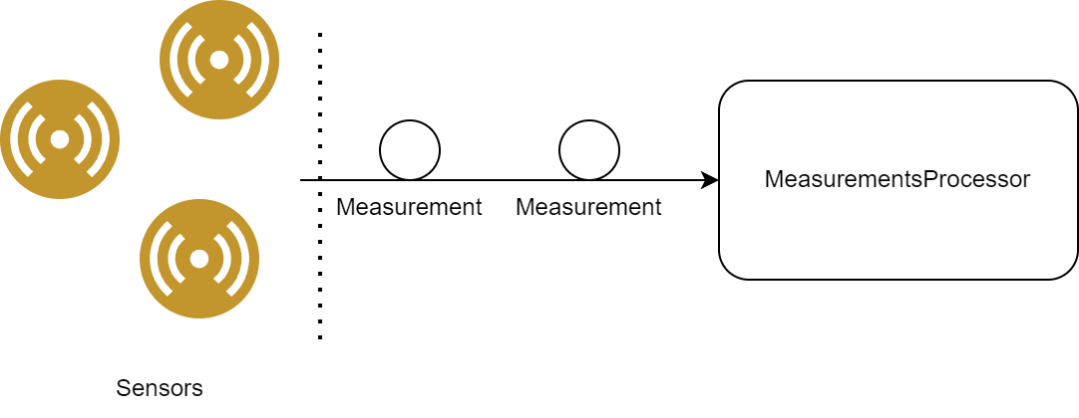

Slide 37
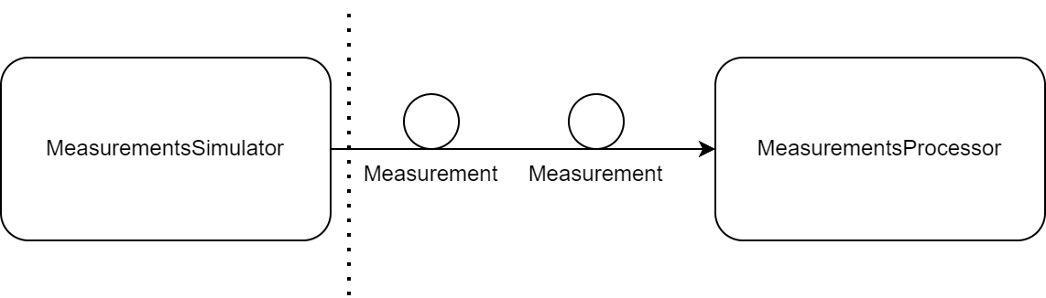

Slide 38
<code>

Slide 39
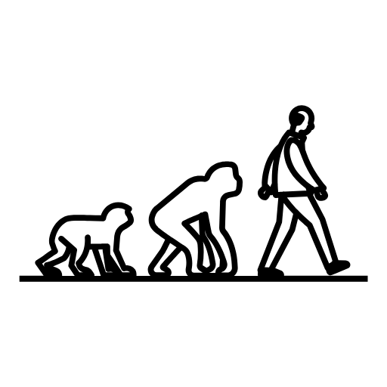


do versioning
prefer
non-breaking
beware of old
version(s)

Slide 40
Notes:
So, did my dream become reality? Is event driven architecture the perfect system? No, it is not.

Slide 41
Notes:
I started this session with my dream to work in the perfect system.

Slide 42
Notes:
Overcoming these obstacles allowed us to tame the event-driven dragon and wield its power.

